Slide 1
Bridge Deck Rehabilitation
Division of Construction Management

Slide 2
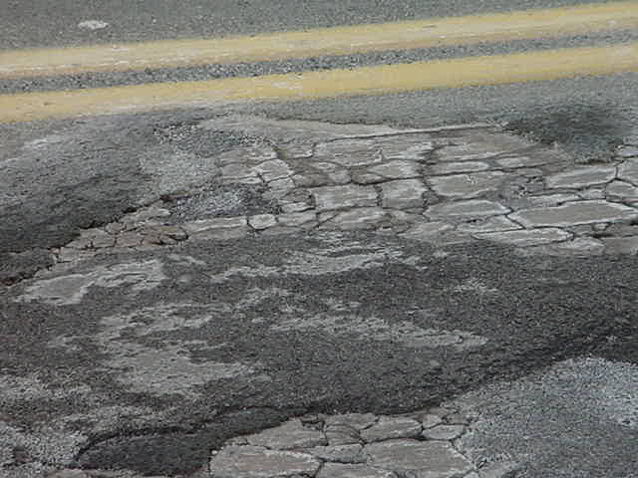
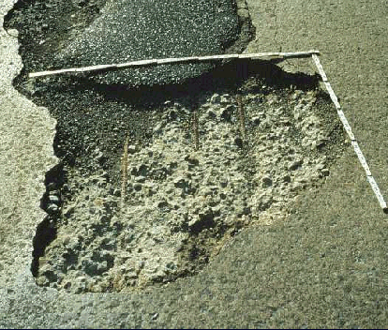
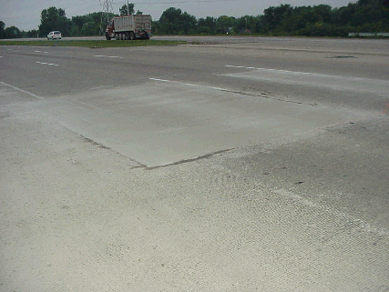
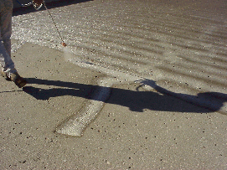
Deck Repair Options
1) Do-Nothing, keep monitoring condition
2) Patch, Hot A.C. crack sealing
3) Seal deck with High Molecular Weight Methacrylate, Soluble Reactive Silicate, Gravity Fed Resin, etc.
4) Place a Micro-Silica, Latex Modified or Superplasticized Dense Concrete Overlay by either SS 847- Scarification Methods or SS 848- Hydrodemolition Methods
5) Replace the deck

Slide 3
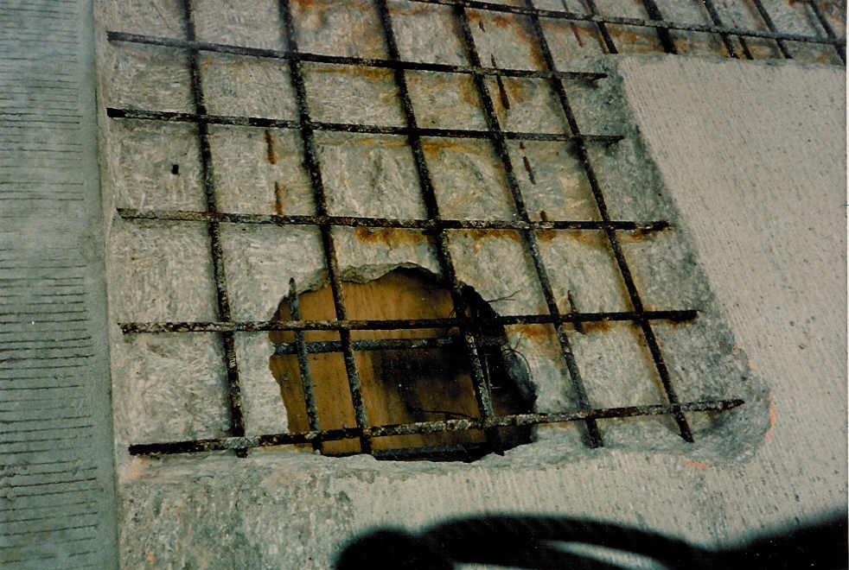
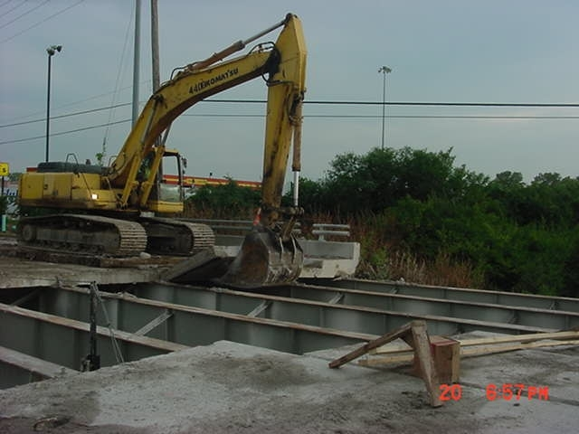
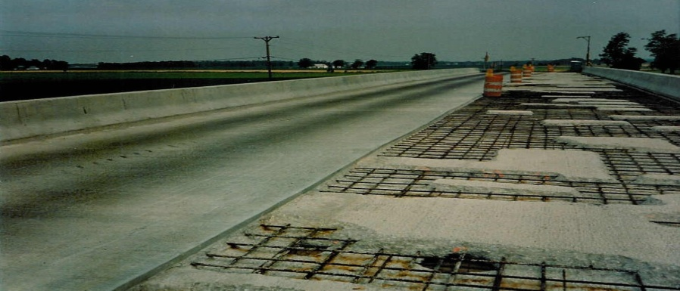
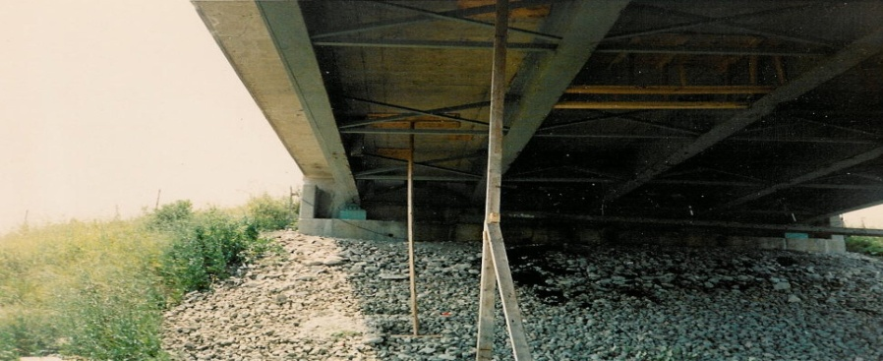
Deck Repair Options
Extending life of structure, Time, Money, Traffic, Rideability

Slide 4
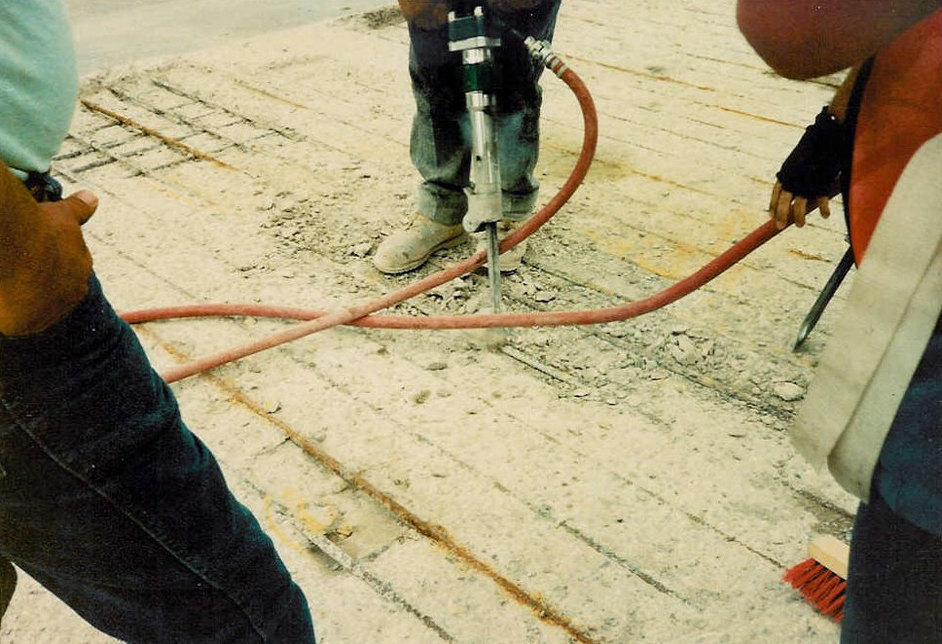
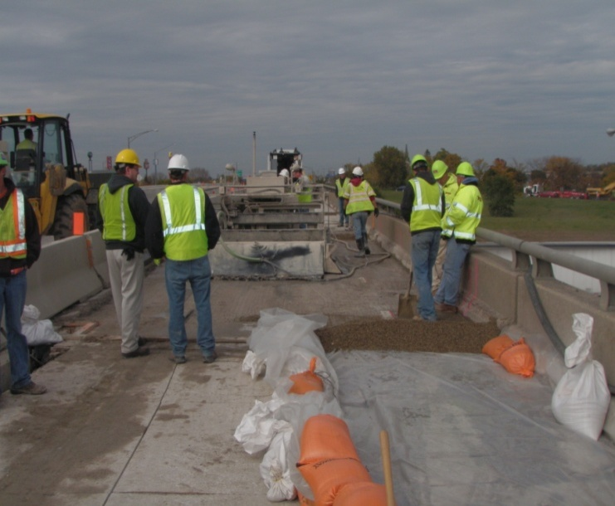
SS 847 and SS 848 Overlay Items
Trying to simplify and clarify SS 847 –Overlays with Scarification & SS 848- Overlays with Hydro-demolition
SS 847 doesn’t have pay items for square yards of Hand Chipping or Removal of Debonded or deteriorated existing variable thickness concrete overlay, which are incidental to Existing Concrete overlay removed__ nominal thickness and - - - Concrete Overlay(variable thickness) items
SS 848 has these items

Slide 5
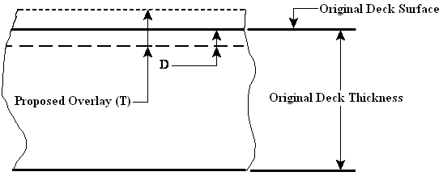
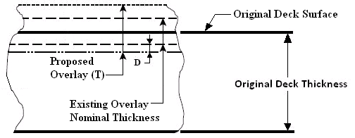
SS 847 and SS 848 Overlay Items
Existing SS 848 says remove at least 1” by Hydro-demolition
In many cases, Contractor has been removing much less than that depth with Hydro-demolition
They having been milling the rest

Slide 6
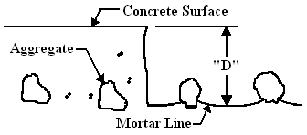
SS 847 and SS 848 Overlay Items
Supplemental Specification 848.20
Concrete Removal by Hydro-demolition
Intent is to remove all unsound
concrete by hydro-demolition, not by
scarification or jacking.
Remove top surface of concrete deck
to depth “D” of 1 inch, or as specified in
the plans.
These measurements shall be
minimum & be taken from the
concrete surface, immediately prior
to the hydro-demolition removal, to
the mortar line.

Slide 7
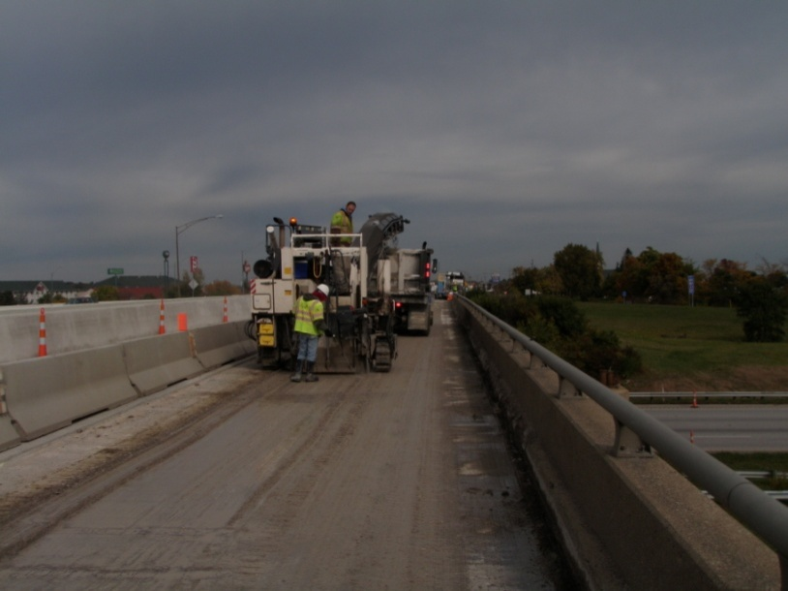
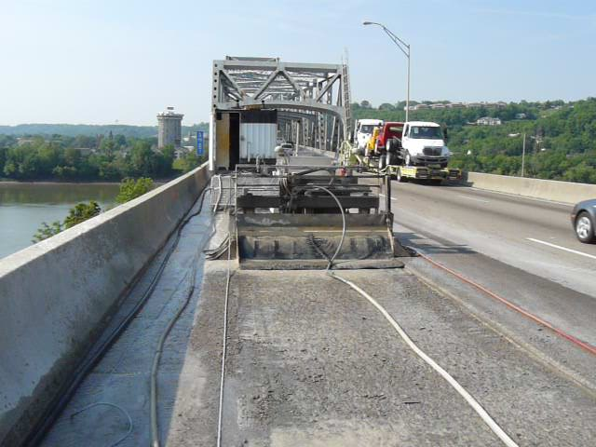
SS 847 and SS 848 Overlay Items
Supplemental Specification 848.20
Concrete Removal by Hydro-demolition
May use conventional scarification equipment to make an initial pass across the deck to remove any existing overlay and a maximum of ¼ inch, or as specified in the plans, of the existing deck concrete.
The final 1 inch shall be removed by Hydro-demolition.

Slide 8
SS 847 and SS 848 Overlay Items
This specification is not necessarily intended to apply to “weekend” overlays, where speed of removal is critical. Variations to this process would have to be specified in an “as per plan” note.
Add Lump Sum item for Hydro-demolition testing.
Since Hydro-demolition doesn’t do a good job removing existing overlays, especially Latex Modified Concrete, propose leaving Removal of Debonded Existing Variable Thickness Overlay item in SS 848, but make hand chipping incidental to ___ Concrete overlay(variable thickness) item,(not material only)

Slide 9
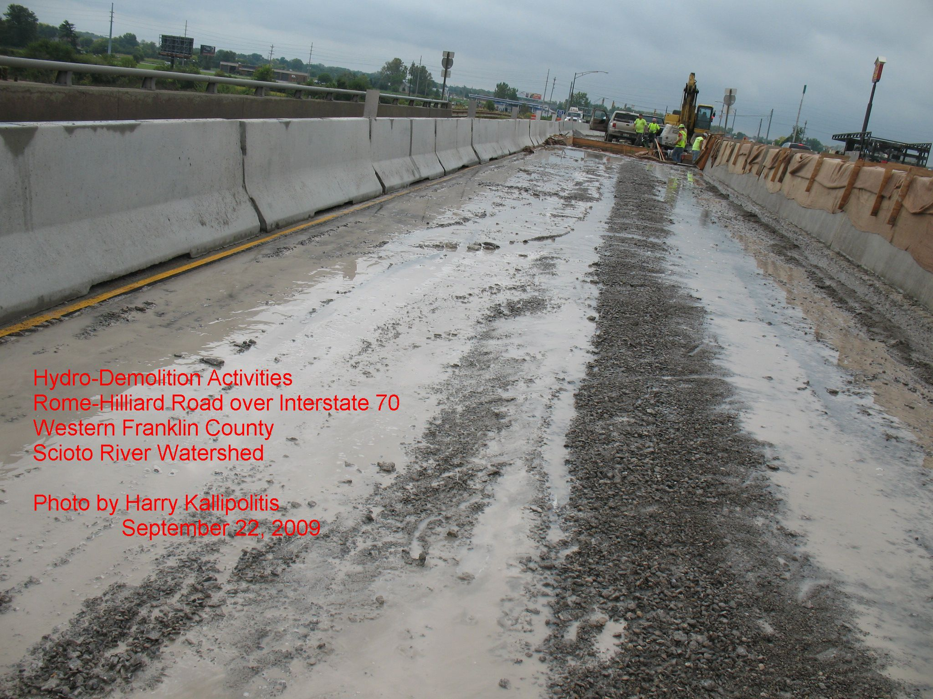
Environmental and Regulatory Issues

Slide 10
Regulatory Issues
Storm Water Run off
Storm water runoff is generated when precipitation from rain and snowmelt events flows over land or impervious surfaces and does not percolate into the ground.

Slide 11
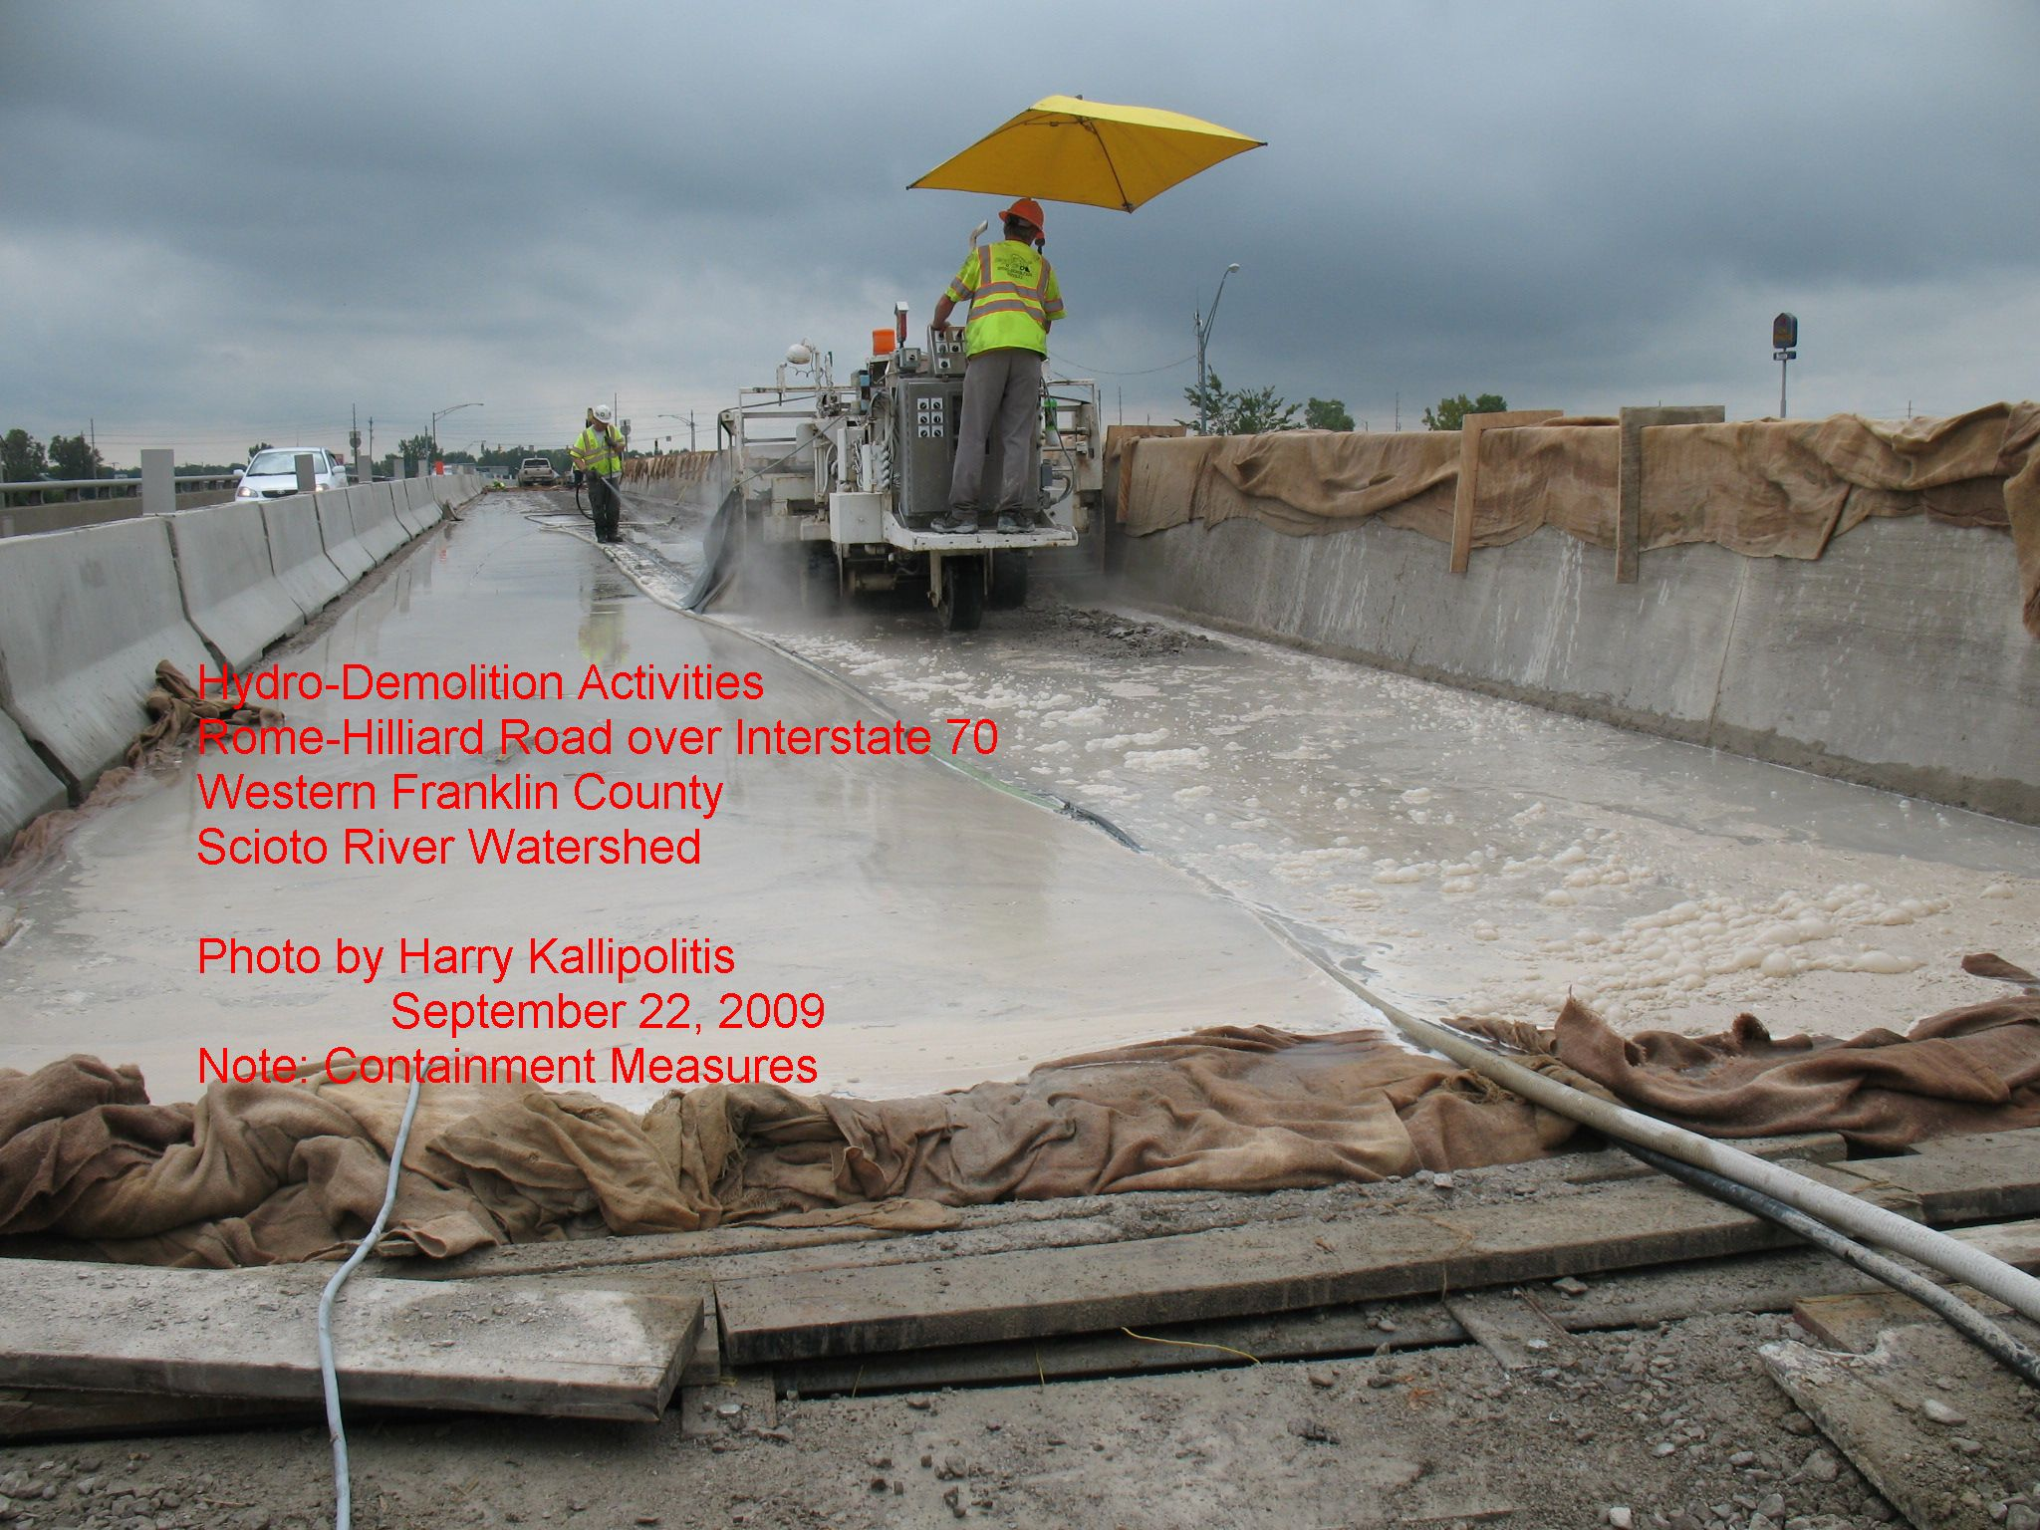
Regulatory Issues
Process waste water
Water that comes in contact with any raw material, product, by-product, or waste during any production or industrial process.

Slide 12
Regulatory Issues
Clean Water Act of 1977
Control of discharges are required for all confined discrete conveyances.

Slide 13
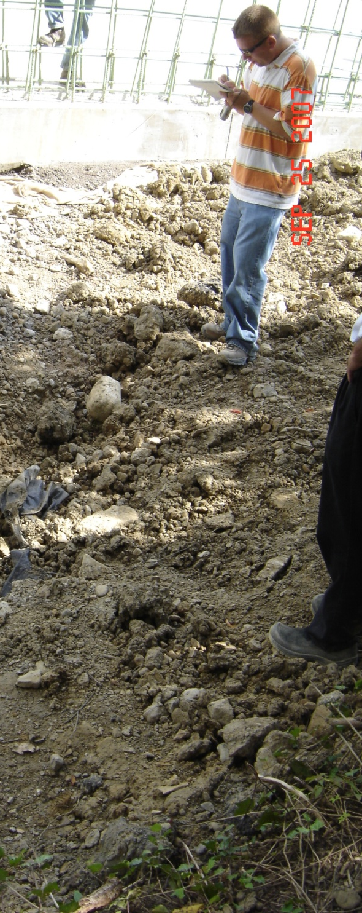
Regulatory Issues
May 2009 – A “Contractor ” contacted OEPA/SWDO inquiring about requirements for the disposal of Hydro-demo waste water.
OEPA…“This is something I think we will need to look at internally”

Slide 14
Regulatory Issues
August 19, 2009 MS4 Notice of Violation;
ODOT Contractor was “Discharging cement slurry, sand and gravel to a storm sewer”
Upon notice the contractor modified his operation and started hauling the waste water for off site disposal.
September 3, 2009 OEPA asks for manifests for proof of disposal

Slide 15
Regulatory Issues
September 15, 2009 - An Environmental Watchdog group notifies OEPA of wastewater discharges in “clear violation of the law”

Slide 16
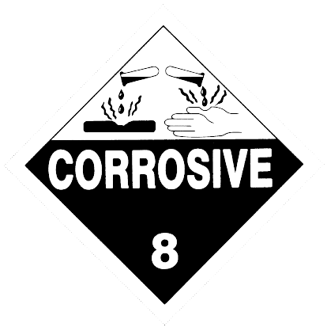
Regulatory Issues
September 22, 2009 - OEPA samples an active hydro operation and finds the wastewater hazardous by characteristic (at or above pH 12.5)

Slide 18
Regulatory Issues
Contain collect characterize… requirement implemented on all projects with hydro demolition
ODOT & OEPA Negotiate a regulatory platform to allow on site land application as a method of disposal

Slide 19
Regulatory Issues
Disposal options
Recycle - deliver the waste to a facility that has a use for the material
NPDES permitted treatment facility (POTW)
Land Application Permit to Install
Contractor files an NOI and performs the work compliant with the Permit to Install
Disposal by land application on area designated in the plans

Slide 20
DIRECT DISCHARGES ARE PROHIBITED
An NPDES direct discharge permit is required for the direct discharge of wastewater to waters of the state.
Beneficial use designations
Low thresholds for dissolved solids, pH, metals, temperature, etc.
General permit does not exist
Statewide permit will be very difficult to obtain

Slide 21
Recycling
Deliver the spent water to a facility that has a use for it.
Hazardous material handling considerations
ODOT will require documentation that accounts for the volume of recycled water

Slide 22
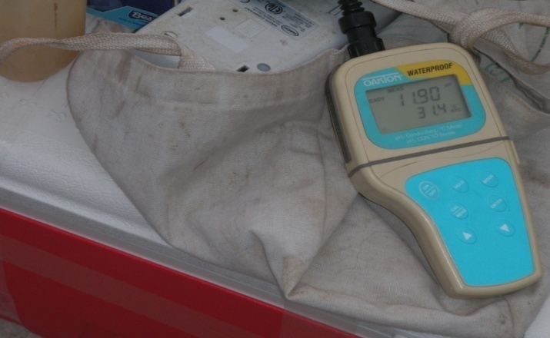
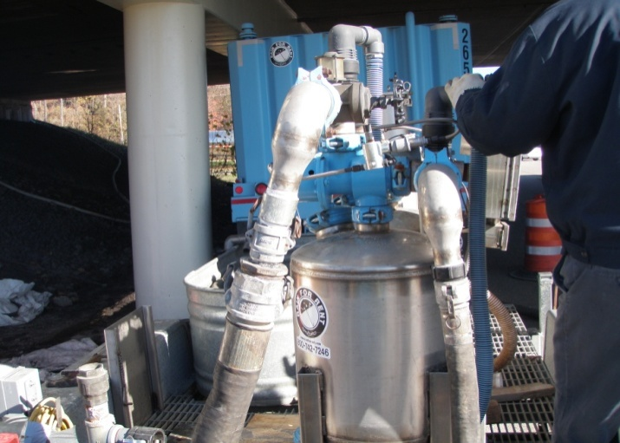
POTW DISPOSAL
SS 847 and SS 848 currently requires costly lab analysis
ODOT is collecting this waste characterization information to develop “Generator Knowledge”
Generator knowledge is a key element needed to pursue a direct discharge permit in the future
The POTW may require some testing prior to disposal at the facility
The requirements of the POTW are independent of the ODOT lab analysis described in the specification

Slide 23
OHIO ENVIRONMENTAL PROTECTION AGENCY
******************DRAFT*******************
GENERAL WASTEWATER DISPOSAL SYSTEM PERMIT TO INSTALL (PTI) FOR LAND APPLICATION OF HYDRO-DEMOLITION WASTEWATER UNDER OHIO ADMINISTRATIVE CODE CHAPTER 3745-42 AND OHIO REVISED CODE CHAPTER 6111.

Slide 24
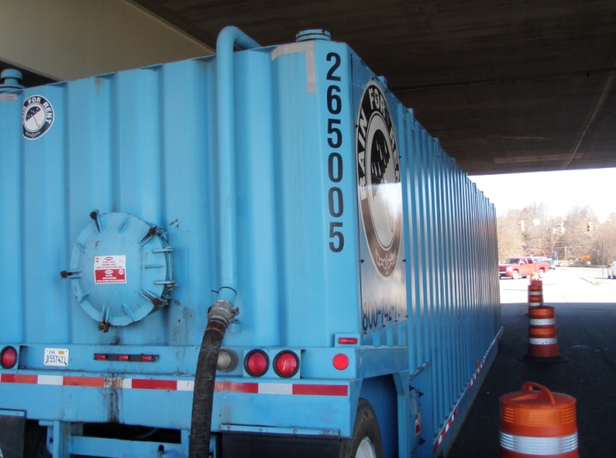
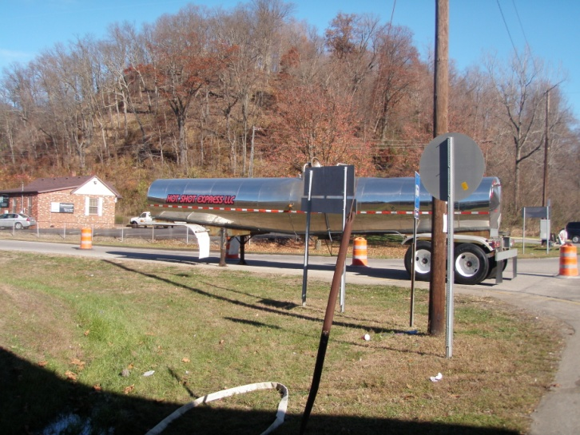
Land Application disposal by Permit
Land application disposal is not required
General wastewater disposal system PTI can be activated on eligible sites by submitting a complete NOI
The PTI will remain active for 1 year a 6 month extension is available upon formal request to the agency

Slide 25
NOI Requirements
Land application plan sealed by an Ohio PE
Description of the equipment to be used for land application
Expected amount the be land applied
Land to be utilized for land application
Location of all storm sewers or catch basins in land application area

Slide 26
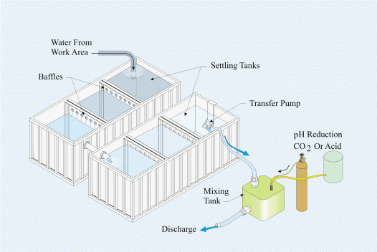
NOI Requirements
Drawing(s) that describe the processes that:
Generate, collect, treat and dispose of the wastewater
Locate each major process unit and describe the types and quantities of the pollutants generated by each
Identify the average and maximum daily flow rate (gallons/day)

Slide 27
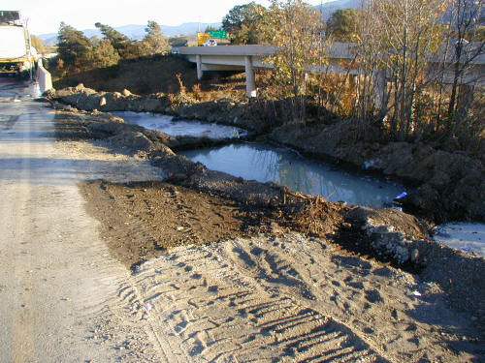
NOI Requirements
NOI is limited to a maximum of 2000 LF of bridge deck.
Large projects may require multiple NOIs
Check dams, unlined impoundments, closed containers or tanks may be used for collecting and/or settling the wastewater prior to land application

Slide 28
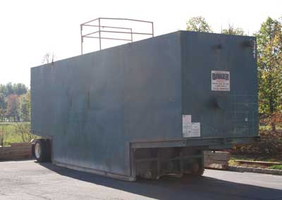
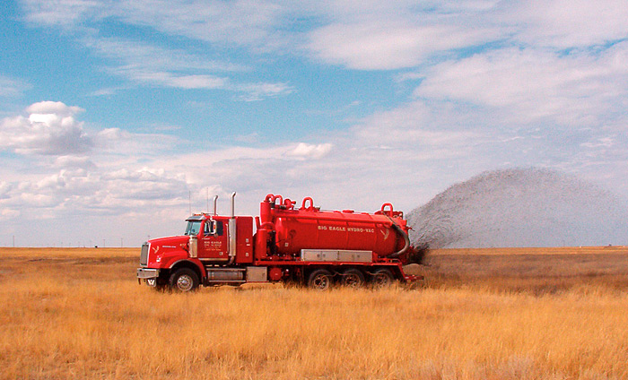
Land Application Restrictions
1. Site inspected for suitability
2. Setbacks from waterways maintained (Table in Permit)
3. Block all drains/catch basins
4. Do not cause ponding or runoff
5. Notify EPA of any spills

Slide 29
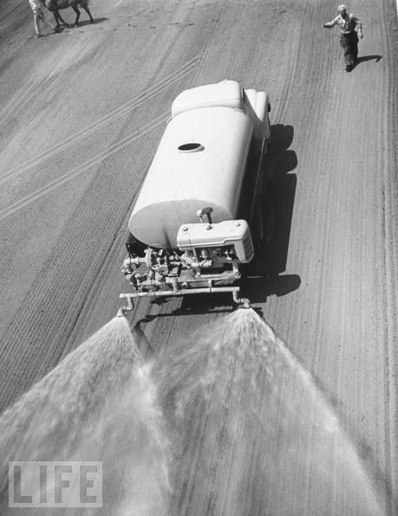
Land Application Restrictions
Land application is permitted on areas designated by the owner of the State ROW
Maximum rate for application shall be <10,000 gal/acre
Do not place on saturated, frozen soils, or when rain is forecast
Maintain daily records
Maximum 25% slope

Slide 30
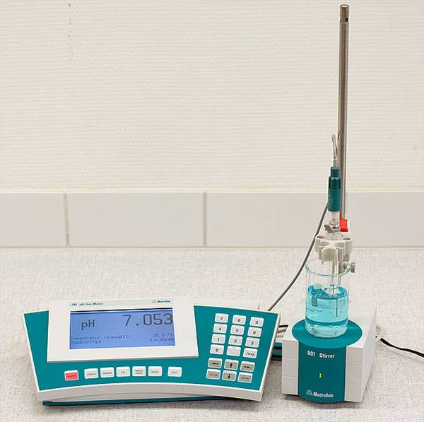
Hazardous Threshold
Material meeting the criteria for hazardous waste shall be handled in strict accordance with Federal hazardous waste rules and laws
These materials include untreated or treated wastewater at or above a pH of 12.5

Slide 31
The Learning Curve

